Slide 1
Kusto Scripting Module
December 30, 2019

Slide 2
Kusto Query Language
A Kusto query is a read-only request to process data and return results. The request is stated in plain text, using a data-flow model designed to make the syntax easy to read, author, and automate. The query uses schema entities that are organized in a hierarchy similar to SQL's: databases, tables, and columns.
The query consists of a sequence of query statements, delimited by a semicolon (;), with at least one statement being a tabular expression statement which is a statement that produces data arranged in a table-like mesh of columns and rows. The query's tabular expression statements produce the results of the query.

Slide 3
Kusto Query Language
The syntax of the tabular expression statement has tabular data flow from one tabular query operator to another, starting with data source (e.g. a table in a database, or an operator that produces data) and then flowing through a set of data transformation operators that are bound together through the use of the pipe (|) delimiter.
For example, the following Kusto query has a single statement, which is a tabular expression statement. The statement starts with a reference to a table called StormEvents (the database that host this table is implicit here, and part of the connection information). The data (rows) for that table are then filtered by the value of the StartTime column, and then filtered by the value of the State column. The query then returns the count of "surviving" rows.

Slide 4
Kusto Query Language
We use Kusto queries to gather a lot of information. You will see many examples throughout this training of how we use Kusto to provide answers and solutions to our customers. The remaining of this module will be covering the commands, syntax, and examples of how we use Kusto to gather information.

Slide 5
KQL Agenda
Azure Kusto Interface
Query Operations
Kusto Explorer
Kusto Explorer Example Queries

Slide 6
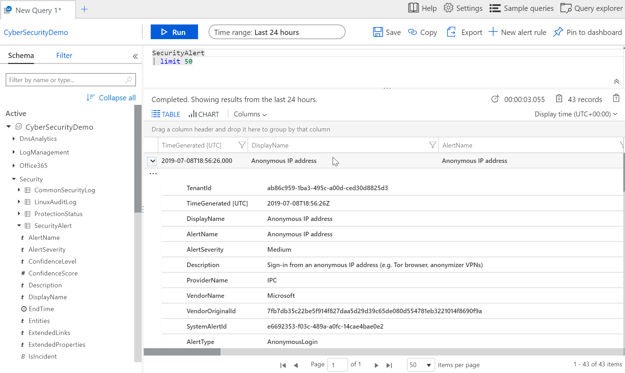
Queries
Tables
Results
Typed columns

Slide 7
Language structure and syntax
The basic structure of KQL is “pipeline” concept. Starting with original source of data, add expressions separated by pipes (“|”). Each expression acts on the results of the previous operator.
{Table}
| where {Filter}
| extend {Column} = {Manipulations}
| project {Columns}
| summarize {Aggregation}
| order by {Columns}
| limit {Number}

Slide 8
KQL Column Types
Basic
int, long, real: 5, 5.3
bool: true, false
string: “example”, ‘example’
guid: 57e2411d-ad2f-4646-a52d-6f654d6abc40
Time
datetime: datetime(2016-11-20 22:30:15.4), now(), ago(4d)
timespan: 2d, 20m, time(1.13:20:05.10), 100ms
Complex
dynamic: JSON format

Slide 9
‘where’ command
Filters a table to the subset of rows that satisfy a predicate.
Syntax: T | where Predicate
Examples: SecurityEvent | where TimeGenerated > ago(1d)
SecurityEvent | where * contains “Kusto”
String predicates: ==, has, contains, startswith, endswith, matches regex, etc
Numeric/Date predicates: ==, !=, <, >, <=, >=
Empty predicates: isempty(), notempty(), isnull(), notnull()
Notes:
Use simple comparisons between column names and constants. ('Constant' means constant over the table - so now() and ago() are OK, and so are scalar values assigned using a let statement.)
For example, prefer where Timestamp >= ago(1d) to where floor(Timestamp, 1d) == ago(1d).
Simplest terms first: If you have multiple clauses conjoined with and, put first the clauses that involve just one column. So Timestamp > ago(1d) and OpId == EventId is better than the other way around.

Slide 10
Where command
Where command creates a condition which needs to match a data element.
We can express a where command with multiple conditions types
| where Computer == “ComputerName” – Exact Match
| where Computer contains “Computer” – part of the string matches
| where Computer contains “Comp&ame” – match beginning and ending
| where Computer contains “ComputerName” and EventID == “2130” you can have multiple conditions

Slide 11
‘where’ exercise
SecurityEvent
| where TimeGenerated > ago(1d)
SecurityEvent
| where TimeGenerated > ago(1h) and EventID == 4624 // Successful logon
SecurityEvent
| where TimeGenerated > ago(1h)
| where EventID == 4624
| where AccountType =~ "user" // case insensitive
Perf
| where InstanceName matches regex "^[A-Z]:"

Slide 12
‘limit’ command
Return up to the specified number of rows.
Syntax: T | limit <number>
Example: SecurityEvent | limit 5
Sort is not guaranteed to be preserved.
Consistent result is not guaranteed (when running the same query twice)
Very useful when trying out new queries.
Default limit is 10,000.

Slide 13

Queries (Kusto)
Take
will take a random number of rows from the input data, no guarantee of which rows are returned.
Perf | take 10
good way to test a query without running the query to completion
limit and take, have same meaning

Slide 14
Queries (Kusto)
Print - Outputs single-row with one or more scalar expressions.
Now - Returns the current UTC clock time, optionally offset by a given timespan. This function can be used multiple times in a statement and the clock time being referenced will be the same for all instances.
Ago - Subtracts the given timespan from the current UTC clock time.

Slide 15
Queries (Kusto)
to print a calculation
print 11 * 3
print TheAnswer = 12 * 3

Slide 16
Queries (Kusto)
returns current date and time
print now()

Slide 17
Queries (Kusto)
print ago(1d) show yesterday
print ago(365d) a year ago

Slide 18
Queries (Kusto)
sort by
desc
asc
order by
Between

Slide 19
Queries (Kusto)
Sort the output (descending order)
| sort by Computer, TimeGenerated

Slide 20
Queries (Kusto)
Sort the output (descending order)
| sort by Computer asc
, TimeGenerated asc

Slide 21
Queries (Kusto)
To get values between values
Perf
| where counterName == "% Free space"
| where counterValue between (79.0 .. 100.0)

Slide 22
LAB One
Create the query for this lab

Slide 23
‘count’ command
Returns the number of records in the input record set.
Syntax: T | count
Example: SecurityEvent | count

Slide 24
Queries (Kusto)
Count
count the number of rows that match the query
Perf | count

Slide 25
‘count’ exercise
OfficeActivity
| count
SecurityEvent
| where TimeGenerated > ago(1h)
| where EventID == 4624
| count

Slide 26
‘limit’ & ‘count’ exercise
What’s the difference between the below query results?
SecurityEvent
| where TimeGenerated > ago(2d)
| limit 10
| count
SecurityEvent
| limit 10
| where TimeGenerated > ago(2d)
| count

Slide 27
‘summarize’ command
Produces a table that aggregates the content of the input table.
Syntax: T | summarize [Aggregation] [by Group Expression]
Examples: SecurityEvent | summarize count() by Computer
SecurityEvent | summarize by Computer
SecurityEvent | summarize max(TimeGenerated)
Simple aggregation functions: count(), sum(), avg(), min(), max(),
Advanced functions (next slide): arg_min(), arg_max(), percentiles(), makelist(), mvexpend(), countif()
No Group Expression implies ‘distinct’.

Slide 28
‘summarize’ exercise
Perf
| where CounterName == "Free Megabytes"
| where InstanceName matches regex "^[A-Z]:$"
| summarize min(CounterValue)
SecurityEvent
| where TimeGenerated > ago(1h)
| where EventID == 4624
| summarize count() by AccountType, Computer
// Multiple aggregations
SecurityEvent | summarize
AdminSuccessfullLogons =
countif(Account contains "Admin" and EventID == 4624), AdminFailedLogons =
countif(Account contains "Admin" and EventID == 4625)

Slide 29
More ‘summarize’ examples
UpdateSummary
| where TimeGenerated > ago(7d)
| summarize arg_max(TotalUpdatesMissing, TimeGenerated) by SourceComputerId
UpdateSummary
| where TimeGenerated > ago(7d)
| summarize arg_max(TotalUpdatesMissing, TimeGenerated)
SecurityEvent
| summarize makelist(Account) by Computer

Slide 30
LAB Two
Create the query for this lab

Slide 31
Quiz
What is the difference between the following queries?
SecurityEvent
| summarize arg_max(TimeGenerated, *) by Account
| where EventID == "4624"
| count
SecurityEvent
| where EventID == "4624"
| summarize arg_max(TimeGenerated, *) by Account
| count

Slide 32
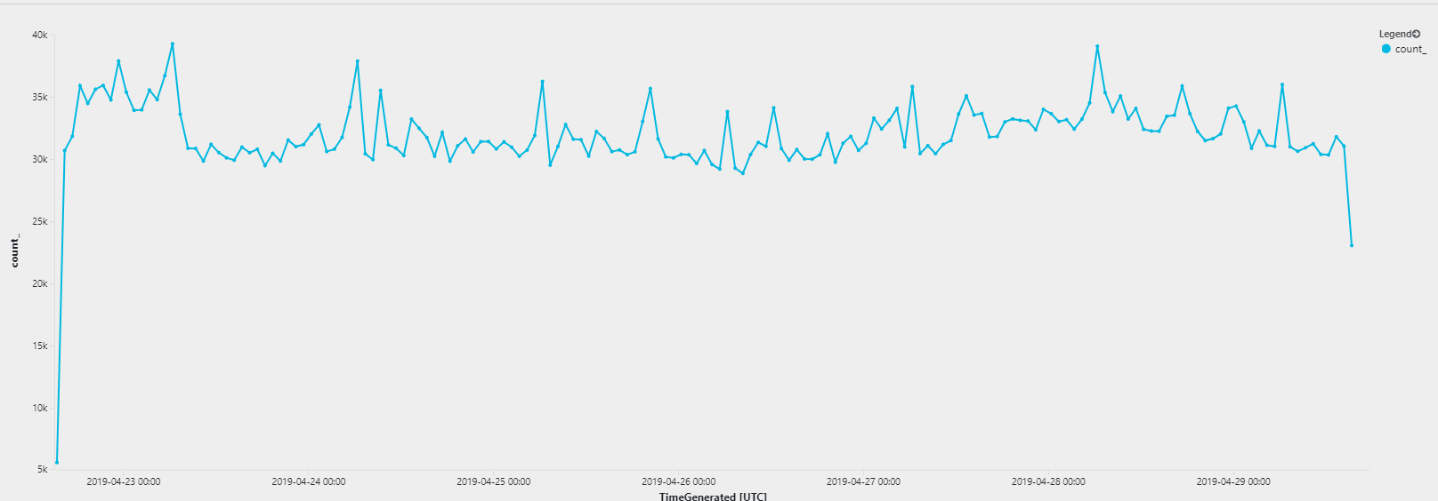
‘summarize’: bin and time series
A very useful summarize operation is creating time series:
SecurityEvent
| summarize count() by bin(TimeGenerated, 1h)
| render timechart // optional!
* Other time measurements: 1h, 5d, 10m
* Can create multiple legends by aggregating additional field

Slide 33
‘bin’ exercise
SecurityEvent
| where TimeGenerated > ago(7d)
| summarize count() by bin(TimeGenerated, 1d)
Perf
| where CounterName == "Free Megabytes"
| where InstanceName matches regex "^[A-Z]:$"
| summarize min(CounterValue) by bin(TimeGenerated, 1d), InstanceName

Slide 34
LAB Three
Create the query for this lab

Slide 35
‘extend’ command
Create calculated columns and append them to the result set.
Syntax: T | extend ColumnName [= Expression] [, ...]
Example: SecurityEvent | extend ComputerNameLength = strlen(Computer)
The new added column is not indexed.
To only change a column name, use ‘project-rename’.
Useful function for in ‘extend’: iff, extract

Slide 36
Queries (Kusto)
Extend
Creates a calculated column and adds to the results set.
Perf
| where CounterName == "free Megabytes"
| extend FreeGB = CounterValue / 1000
, FreeKB = CounterValue * 1000

Slide 37
‘project’ command
Select the columns to include, rename or drop, and insert new computed columns.
Syntax: T | project ColumnName [= Expression] [, ...]
Example: SecurityEvent | project TimeGenerated, Computer
‘| project-away’ – Removed specified column/s.
‘| project-rename’ – Rename specified column/s.

Slide 38
‘extend’ & ‘project’ exercise
Perf
| where CounterName == "Free Megabytes"
| where InstanceName == "C:"
| extend FreeKB = CounterValue * 1000
| extend FreeGB = CounterValue / 1000
Perf
| where CounterName == "Free Megabytes"
| project Computer , CounterName , CounterValue
SecurityEvent
| extend IsImportant = iff(Computer contains "CEO", true, false)

Slide 39
‘distinct’ command
Produces a table with the distinct combination of the provided columns of the input table.
Syntax: T | distinct Column1, Column2
Example: SecurityEvent | distinct Computer

Slide 40
Queries (Kusto)
distinct
list of unique values
distinct ObjectName, counterName“
Event
Distinct can be used to limit a result set
Get a list of all source that had an error event
Event
| where EventLevelName == ""Error“ "distinct Source“
top
Top returns the first 'n' rows of the dataset when the dataset is sorted by the 'by' clause
Perf
| top 20 by TimeGenerated desc"
desc descending order
asc ascending order

Slide 41
‘order by’ & ‘top’ operator
Order by: Sort the rows of the input table into order by one or more columns.
Top: returns the top values after sort. Faster and can sort by expression
Syntax: T | sort by column [asc | desc] [nulls first | nulls last]
T | top NumberOfRows by Expression [asc | desc] [nulls first | nulls last]
Example: Table | order by country asc, price desc
Don’t assume order by default

Slide 42
‘order by’ / ‘top’ exercise
SecurityEvent
| order by TimeGenerated desc
| limit 100 // try also top
SecurityEvent
| top 100 by TimeGenerated desc
SecurityEvent
| where EventID == 4624
| summarize cnt=count() by Account
| top 10 by cnt

Slide 43
LAB Four
Create the query for this lab

Slide 44
‘extract’ function
Get a match for a regular expression from a text string.
Syntax: extract(regex, captureGroup, text [, typeLiteral])
Example: extract("x=([0-9.]+)", 1, "hello x=45.6|wo") == "45.6“

Slide 45
Queries (Kusto)
Extract
to extract values from output
Perf
| where ObjectName == ""LogicalDisk""and InstanceName matches regex ""[A-Z]:"“
| project Computer, CoutnerName, extract(""[A-Z]"":"", 0, InstanceName)
0 means match regex only
1 means return only what in the parenthesis"

Slide 46
‘let’ statement
Let statements bind names to expressions.
Declare global ‘variable’ or reuse of ‘variables’.
let timeOffset = 7d;
let discardEventId = 4688;
SecurityEvent
| where TimeGenerated > ago(timeOffset*2) and TimeGenerated < ago(timeOffset)
| where EventID != discardEventID
Store and/or reuse of query runs
Declare functions
Declare dynamic table

Slide 47
‘let’ statement
Let statements bind names to expressions.
Declare global ‘variable’ or reuse of ‘variables’.
Store and/or reuse of query runs
Declare functions
Declare dynamic table

Slide 48
‘let’ statement
Let statements bind names to expressions.
Declare global ‘variable’ or reuse of ‘variables’.
let timeOffset = 7d;
let discardEventId = 4688;
SecurityEvent
| where TimeGenerated > ago(timeOffset*2) and TimeGenerated < ago(timeOffset)
| where EventID != discardEventID
Store and/or reuse of query runs
Declare functions
Declare dynamic table

Slide 49
‘let’ statement
Let statements bind names to expressions.
Declare global ‘variable’ or reuse of ‘variables’.
Store and/or reuse of query runs
let queryResultA =
SecurityEvent
| where count_ < 10;
queryResultA
| where Account contains “Mal”
Declare functions
Declare dynamic table

Slide 50
‘let’ statement
Let statements bind names to expressions.
Declare global ‘variable’ or reuse of ‘variables’.
Store and/or reuse of query runs
Declare functions
let dateDiffInDays = (date1: datetime, date2: datetime) { (date1 - date2) / 1d };
print dateDiffInDays(now(), todatetime("2018-05-01"))
Declare dynamic table

Slide 51
‘let’ statement
Let statements bind names to expressions.
Declare global ‘variable’ or reuse of ‘variables’.
Store and/or reuse of query runs
Declare functions
Declare dynamic table
// Declaring constant datatables
let birthdays = datatable(ID: int, employeeName: string, birthdate: datetime)
[ 1, "Ziv", datetime(1987,12,16)
, 2, "Jason", datetime(1984,04,02)
];
birthdays | where birthdate < ago(30y)
// later we can use this watchlist to match other tables (join)

Slide 52
‘union’ operator
Takes two or more tables and returns the rows of all of them.
Example:
SecurityEvent | union (SecurityAlert | where Severity > 3)
kind=inner(common columns), outer (all columns- default)
Supports wildcard to union multiple tables (union Security*)
Can union between tables from different clusters (or workspaces)

Slide 53
‘union’ exercise
SecurityEvent
| union Heartbeat
| summarize count() by Computer

Slide 54
LAB Five
Create the query for this lab

Slide 55
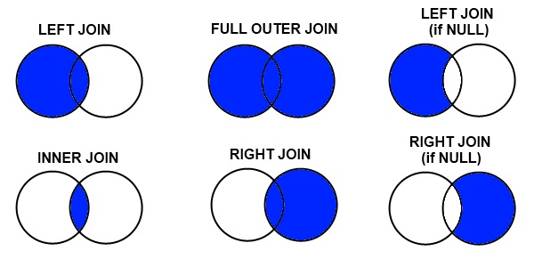
‘join’ operator
Merge the rows of two tables to form a new table by matching values of the specified column(s) from each table.
Syntax: LeftTable | join [JoinParameters] ( RightTable ) on Attributes
Example: SecurityEvent | join (SecurityAlert | where Severity > 3) on Account

Slide 56
Queries (Kusto)
Parse
Evaluates a string expression and parses its value into one or more calculated columns.
Syntax
T | parse [kind=regex [flags=regex_flags] |simple|relaxed] Expression with * (StringConstant ColumnName [: ColumnType]) *...
Arguments
T: The input table.
kind:
simple (the default) : StringConstant is a regular string value and the match is strict which means that all string delimiters should appear in the parsed string and all extended columns must match the required types.
regex : StringConstant may be a regular expression and the match is strict which means that all string delimiters (which can be a regex for this mode) should appear in the parsed string and all extended columns must match the required types.
flags : Flags to be used in regex mode like U (Ungreedy), m (multi-line mode), s (match new line \n), i (case-insensitive) and more in RE2 flags.
relaxed : StringConstant is a regular string value and the match is relaxed which means that all string delimiters should appear in the parsed string but extended columns may match the required types partially (extended columns that didn't match the required types will get the value null).
Expression: An expression that evaluates to a string.
ColumnName: The name of a column to assign a value (taken out of the string expression) to.
ColumnType: should be Optional scalar type that indicates the type to convert the value to (by default it is string type).
Returns
The input table, extended according to the list of columns that are provided to the operator.

Slide 57
Queries (Kusto)
Parse
Example:
print msg = "DeviceUUID: 8e13b3d0-58c6-11e6-b4f5-c326b4de675a, AccessControlRuleAction: Allow, SrcIP: 192.168.1.1, DstIP: 192.168.1.2, SrcPort: 55000, DstPort: 53803, Protocol: tcp, IngressInterface: s2p1, IngressZone: External, ACPolicy: IDS Access Control Policy, AccessControlRuleName: NetworkAMP, Prefilter Policy: Unknown, User: No Authentication Required, ConnectionDuration: 155, InitiatorPackets: 4, ResponderPackets: 0, InitiatorBytes: 428, ResponderBytes: 0, NAPPolicy: NT Passive NAP Policy"
| where msg startswith "DeviceUUID: "
| parse msg with "DeviceUUID: " myDeviceUUID
"AccessControlRuleAction: " myAction
"SrcIP: " mySrcIP
"DstIP: " myDstIP
"SrcPort: " *
| project myDeviceUUID,myAction,mySrcIP,myDstIP

Slide 58
Queries (Kusto)
Startof/Endof
we can get info based on startof and endof
startofday “
Event
| where TimeGenerated >= ago(7d)
| extend DayGenerated = startofday(TimeGenerated)
| project Source,TimeGenerated,DayGeneratedsummarize EventCount=count()by DayGenerated, Source"
startofmonth
Event
| where TimeGenerated >= ago(365d)
| extend MonthGenerated = startofmonth(TimeGenerated)
| project Source,MonthGeneratedsummarize EventCount=count()by MonthGenerated, Source| sort by MonthGenerated asc, Source asc"
Startofyear
Event
| where TimeGenerated >= ago(365d)| extend YearGenerated = startofyear(TimeGenerated)
| project Source,YearGeneratedsummarize EventCount=count()by YearGenerated, Source| sort by YearGenerated asc, Source asc"
startofweek
Event
| where TimeGenerated >= ago(365d)| extend WeekGenerated = startofweek(TimeGenerated)
| project Source,WeekGeneratedsummarize EventCount=count()by WeekGenerated, Source| sort by WeekGenerated asc, Source asc"

Slide 59
Kusto Explorer
We use Kusto Explorer to query backend data about the customers environment.

Slide 60

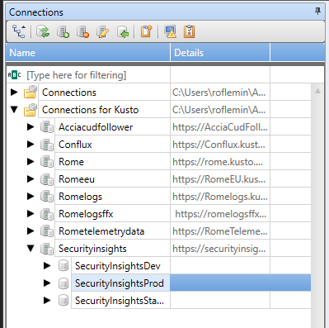
Database Cluster Connections
There are many different database clusters

Slide 61
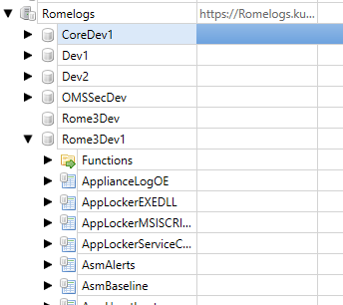
Databases

Slide 62
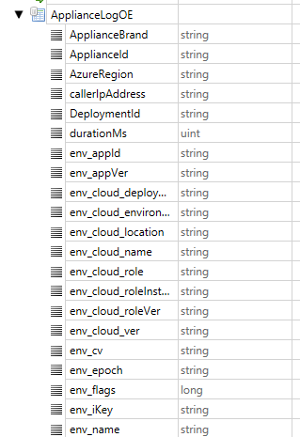
Tables and Records

Slide 63
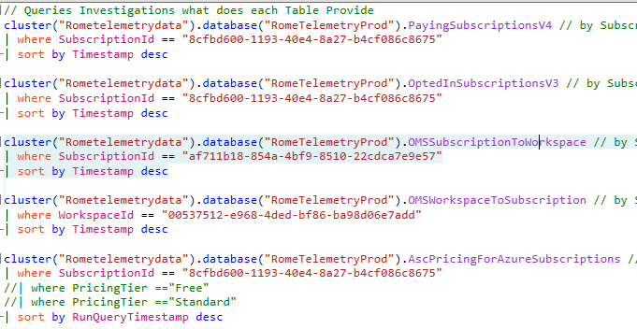
Basic Kusto Query

Slide 64
Major Query Elements
SubscriptionID
AzureResourceID
WorkspaceID
WorkspaceSubscriptionID
TenentID

Slide 65
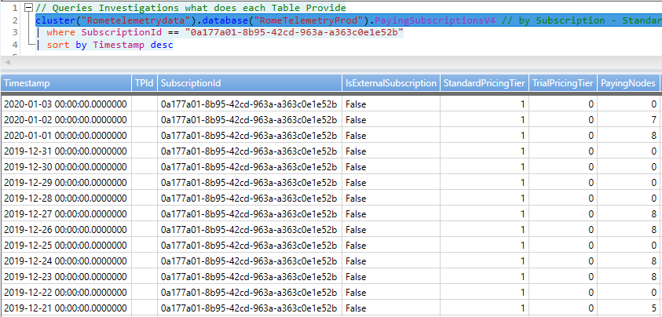
Common Tables and Data
cluster("Rometelemetrydata").database("RomeTelemetryProd").PayingSubscriptionsV4 // by Subscription - Standard tier versus Trial Tier trace over time

Slide 66
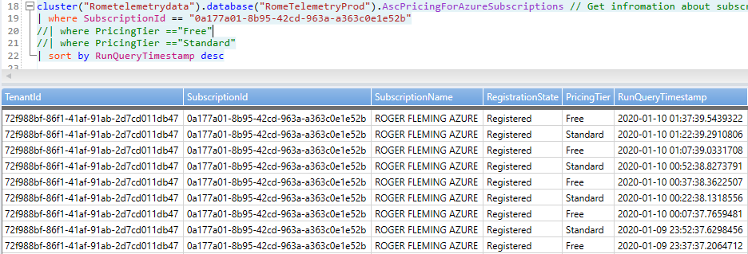
Common Tables and Data
cluster("Rometelemetrydata").database("RomeTelemetryProd").AscPricingForAzureSubscriptions // Get information about subscription (Free/Standard) for Scurity Center

Slide 67
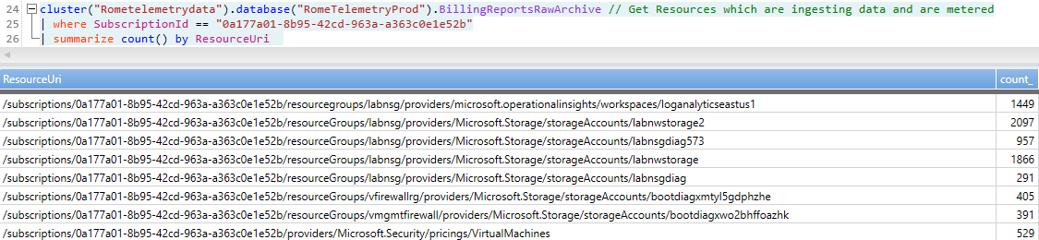
Common Tables and Data
cluster("Rometelemetrydata").database("RomeTelemetryProd").BillingReportsRawArchive // Get Resources which are ingesting data and are metered

Slide 68
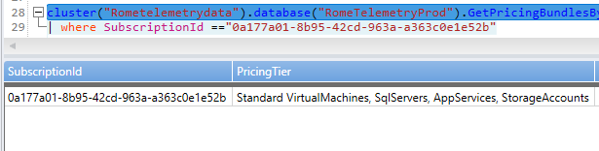
Common Tables and Data
cluster("Rometelemetrydata").database("RomeTelemetryProd").GetPricingBundlesBySubscription() // Get Security Center Covered Products

Slide 69
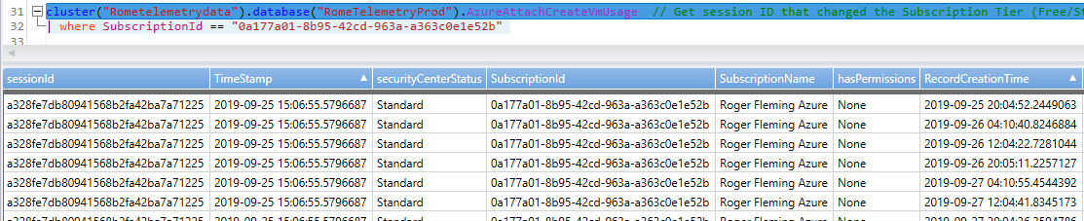
Common Tables and Data
cluster("Rometelemetrydata").database("RomeTelemetryProd").AzureAttachCreateVmUsage // Get session ID that changed the Subscription Tier (Free/Standard)

Slide 70
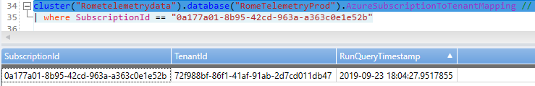
Common Tables and Data
cluster("Rometelemetrydata").database("RomeTelemetryProd").AzureSubscriptionToTenantMapping // get parent TenantId from SubscriptionId

Slide 71
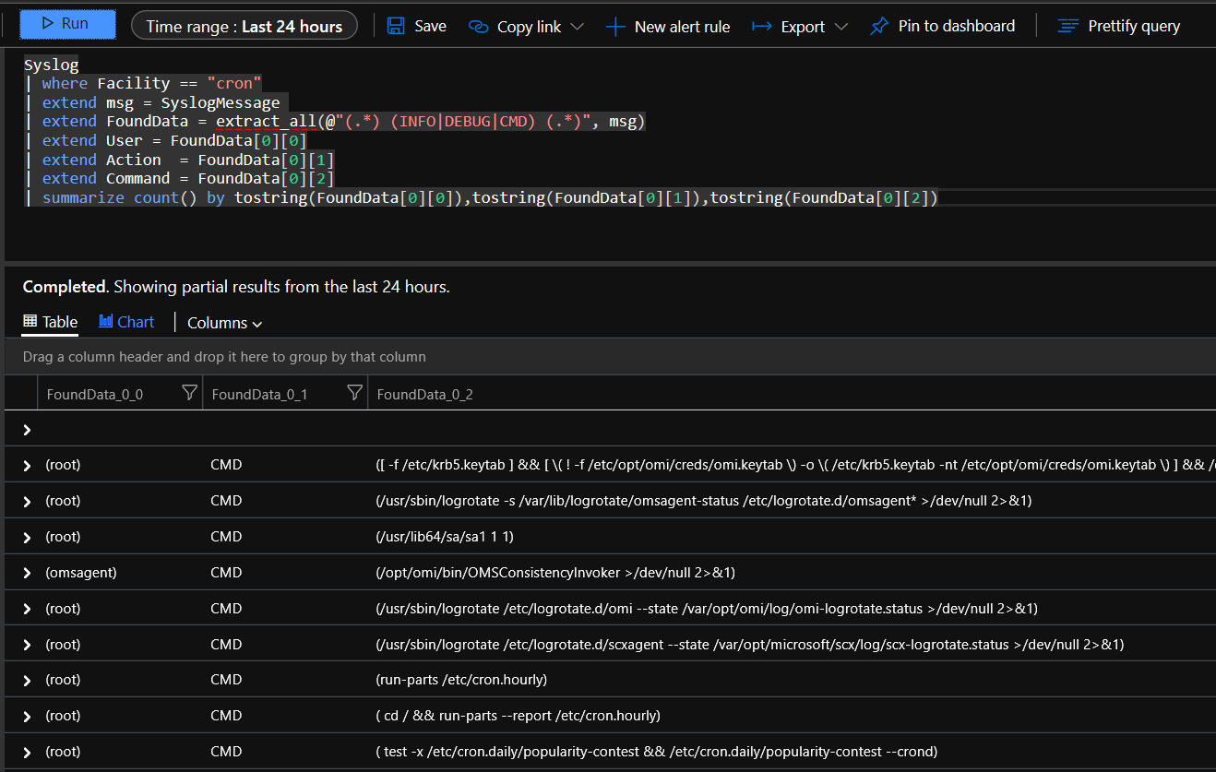
Custom Syslog Parsing and examples
This an example of custom Query for the cron log events

Slide 72
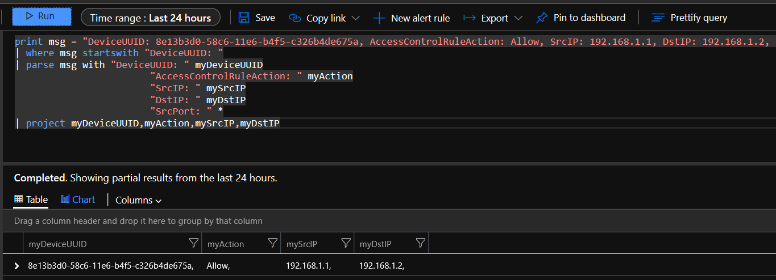
Custom Syslog Parsing and examples
This an example of custom Query for the custom log event

Slide 73
Additional Kusto Queries and Resources
Kusto Respositiory
https://microsoft.sharepoint.com/:f:/t/CSSSecurity2/Eo1FNiv5xzFChx5ve0uud0UBN4NbUH2ZQnyV2qPS4q0ADQ?e=VtBSN9
Kusto Cheat Sheet
https://microsoft.sharepoint.com/:x:/t/CSSSecurity2/EebWAtSqmd5OniTe9wQgR_cBPmUaTW5-vnFlsUMNNoYZGQ?e=Uc6GgN
Kusto Visual Code Program
https://microsoft.sharepoint.com/:f:/t/CSSSecurity2/EsGdzbHn0dBHn3p_NkAZUysBNp225eLNg6bEhINwBalrzw?e=9kUEbY

Slide 74
Where to go from here?
KQL documentation
Pluralsight KQL course
Open to use KQL playground

